Slide 1
PRESENTATION
ON
FLIGHT PRICE PREDICTION PROJECT
Submitted to: Submitted by:
Flip Robo Technologies Priya Rajput

Slide 2
INTRODUCTION
Business Problem Framing
Conceptual Background Of Domain Knowledge
Problem Statement
ANALYTICAL PROBLEM FRAMING
EXPLORATORY DATA ANALYSIS
CONCLUSION WITH FUTURE SCOPE

Slide 3
Business Problem Framing
The airline industry is considered as one of the most sophisticated industry in using complex pricing strategies. Nowadays, ticket prices can vary dynamically and significantly for the same flight, even for nearby seats.
Customers are also becoming more strategic with the development of various online tools to compare prices across various airline companies. In addition, competition between airlines makes the task of determining optimal pricing is hard for everyone.

Slide 4
CONCEPTUAL BACKGROUND OF THE DOMAIN PROBLEM
Check whether the problem is supervised or not.
Check whether model is regression or classification type.
Perform various mathematical and statistical analysis which include description or statistical
summary of the data, correlation using corr() and data visualization . Then we have used zscore to plot outliers and remove them.
Check whether our dataset is balanced or imbalanced. If data is imbalanced, then we apply sampling techniques to balance the dataset.
Building the model and check its accuracy.
Selecting the model, hyperparameter tuning would be done.

Slide 5
Problem Statement
Our main objective of doing this project is to build a model to predict whether the flight price which help the customers to evaluate the price. We are going to predict by using Machine Learning algorithms.
The sample data is provided to us from our client database. In order to improve the selection of customers for the credit, the client wants some predictions that could help them in further investment and improvement in selection of customers

Slide 6
import numpy as np
import pandas as pd
import matplotlib.pyplot as plt
import seaborn as sns

Slide 7
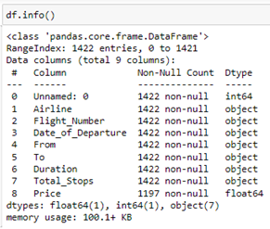
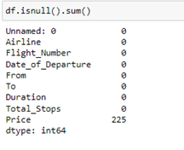

Slide 8

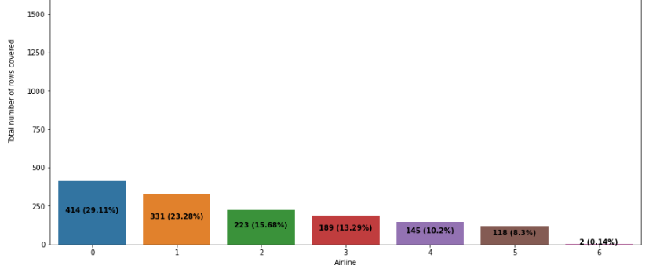
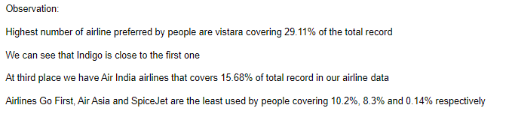

Slide 9
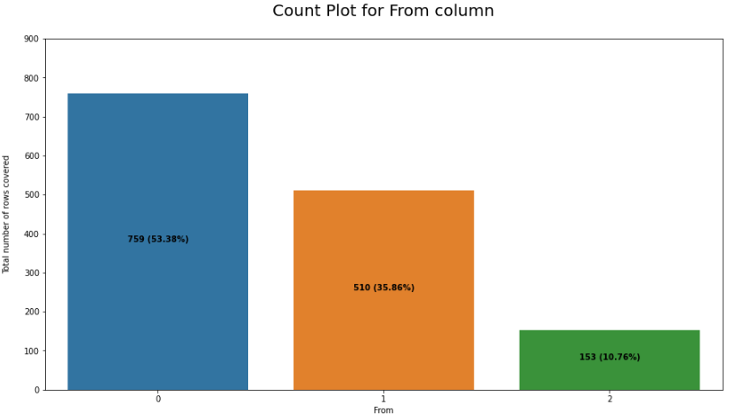


Slide 10
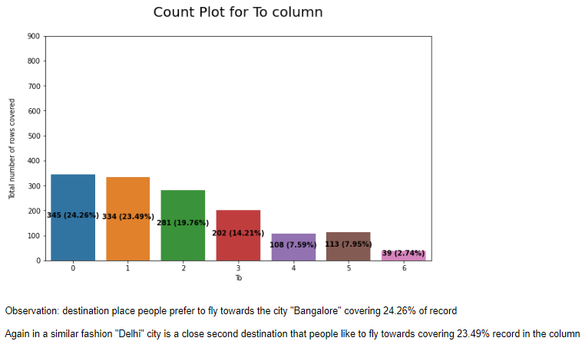

Slide 11

Dropped the column ‘Unnamed:0’ :as it is of no use, it is only giving serial numbers starting from 1
Checked the value counts of the target variable ’Label’ whether the dataset is balanced or imbalanced.
Checked the correlation between dependant and independent variables using heatmap. I have seen many columns which are 0% correlated with the target variable. So, I also have dropped all those columns which are not correlated with the target variable ‘Label’.
Visualization using distribution plots where I can clearly see some outliers and skewness from the plots.

Slide 12
Interpretation of the Results
In the visualization part, we have seen how my data looks like using heatmap, boxplot, distribution plots. In the pre-processing part, we have cleaned data using zscore.
In the modeling part, we have designed our model using algorithms like Extra Tree Classifier, Random Forest Classifier.

Slide 13
Conclusion
In this project we have scraped the flight data from airline webpages. Features like flight duration, number of stops during the journey and the availability of meals are playing major role in predicting the prices of the flights.
It could also help customers to predict future flight prices and plan the journey accordingly because it is difficult for airlines to maintain prices since it changes dynamically due to different conditions. Hence by using Machine Learning techniques we can solve this problem.
The above research will help our client to study the latest flight price market and with the help of the model built he can easily predict the price ranges of the flight, and also will helps him to understand Based on what factors the fight price is decided.

Slide 14
Limitations of the model
Some algorithms are facing over-fitting problem which may be because of a smaller number of features in our dataset.
Limitation of the study is that in the volatile changing market we have taken the data, to be more precise we have taken the data at the time of pandemic and recent data, so when the pandemic ends the market correction might happen slowly.
Therefore based on that again the deciding factors of it may change and we have shortlisted and taken these data from the important cities across India.
If the customer is from the different country our model might fail to predict the accuracy prize of that flight.

Slide 15
Thank You

